Slide 1


Training information technology test
http://schoolacademy.telerik.com
Test on preparation for it the Olympics (NOIT)
Team “Tomas Hardy”

Slide 2
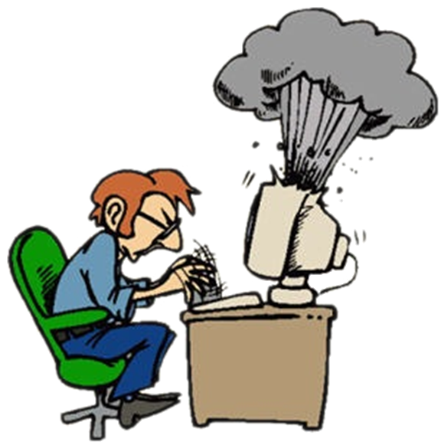

Computer systems
Hardware questions

Slide 3
Computer systems (hardware)
The questions from this section on the compendium shall cover the following areas:
Computer systems.
Major components of computer systems, features, specifications, user interaction.
Basic work principles.
Basic input-output interfaces and standards.

Slide 4
Question
text
What is the chipset?
A set of electronic components in an integrated circuit, which manage the flow of data between processors, memory and periphery
The hardware in the computer that performs the instructions of computer programs through basic arithmetic, logical, and input/output operations on the system
A digital circuit that performs arithmetic and logical operations
The main printed circuit board in computing and other advanced systems
None of the above

Slide 5
Answer
Information: Working with a computer, the term chipset is commonly means "a set of specialized chips", seated on the motherboard or an expansion card. In the personal computer (PC) based on the Intel Pentium architecture, the term is often a specific group of chips on the motherboard: the North Bridge (the Northbridge) and South Bridge (the Southbridge). The bridge connects the CPU to very high-speed devices, especially RAM, graphic controllers, a Southbridge connects with slower peripherals (such as PCI or Isa).
Source:
http://en.wikipedia.org/wiki/Chipset

Slide 6



Software systems
Computer software

Slide 7
Computer programs (software)
The questions from this section on the compendium shall cover the following areas:
Computer programs (software)
Actually, functions, classification.
Create.
Ways of use (installation, startup, uninstall)

Slide 8
Question
Which of the following is not classified as a content access software?
Multimedia player
Word processor
A Web browser
Hybrid editor and player
All are classified as software for access to content

Slide 9
Answer
Information: Content access software is electronic media software which includes: Media Player, Web browser, hybrid editor and player (presentation program). On the other hand, the text working Editor is classified as software for the information worker.
Source:
http://en.wikipedia.org/wiki/Application_software#Application_software_classification

Slide 10


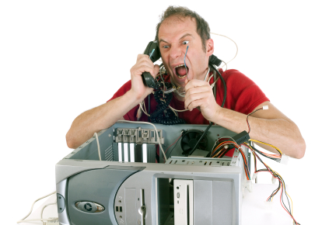
Work with computer systems and programs
Installation, use, maintenance, ...

Slide 11
Work with computer programs
The questions from this section on the compendium shall cover the following areas:
Rules for working with computer systems and programs.
Starting and stopping.
Diagnosis.
Detection of problems.
Maintaining.
Testing.

Slide 12
Question
DiskPart.exe in Windows
Is a text-mode command interpreter
Enables management objects (disks, partitions, or volumes)
Uses scripts
Uses direct input from a command prompt
All of the above

Slide 13
Answer
Information: Diskpart.exe is a text-only interpreter command which allows the management of objects (disks, partitions, or volumes) by using scripts or direct input from a command prompt.
Source:
http://technet.microsoft.com/en-us/library/bb490893.aspx

Slide 14

Data and notations
Channels for data transmission, units of measurement, work with notations

Slide 15
Data transfer. Notations
The questions from this section on the compendium shall cover the following areas:
IT funds for data (different approaches and methods, physical media and channels for transmission, advantages and disadvantages).
Basic units of information.
Basics of binary calculations.
Calculations in different notations.

Slide 16
Question
You have the following IPv6 address 2001:0dh8:85a3:0000:0000:8a2e:0370:7334.
Choose it’s appropriate compact representation:
2001:0dh8:85a3::8a2e:0370:7344
2001:0:85a3:0:0:8a2e:0:7344
2001:dh8:85a3::8a2e:370:7334
No appropriate compact representation

Slide 17
Answer
Information: IPv6 addresses are 128bit long, represented as eight groups of four hexadecimal digits, separated by colons (:). Rules concerning compact representations of IPv6 addresses are described in RFC 3513.
Source:
http://en.wikipedia.org/wiki/IPv6_address
http://tools.ietf.org/html/rfc3513

Slide 18





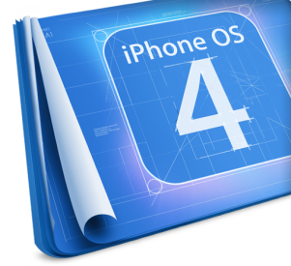









Operating systems
Architecture, processes, users, user interface, file systems

Slide 19
Operating systems
The questions from this section on the compendium shall cover the following areas:
Operating systems – concepts, basic functions and tasks. User interface – concepts, types. Graphical interface – concepts, basic objects, basic operations, organization settings. File – concepts, characteristics. File system – concepts, types, logical and physical organization, basic objects and action with them. Users, processes, multitasking.

Slide 20
Question
Which technique was introduced because a single job could not keep both the CPU and the I/O devices busy?
Time-sharing
SPOOLing
Preemptive scheduling
Multiprogramming
No such technique

Slide 21
Answer
Information: As multitasking greatly improved the throughput of computers, programmers started to implement applications as sets of cooperating processes (e. g., one process gathering input data, one process processing input data, one process writing out results on disk).
Source:
http://en.wikipedia.org/wiki/Computer_multitasking

Slide 22

Software engineering
Analysis, specification, design, prototype, implementation, testing, maintenance, ...

Slide 23
Software engineering
The questions from this section on the compendium shall cover the following areas:
Main phases of the project – analysis, modeling, design, prototype, implementation, verification (testing and quality assurance), improving and perfecting, documenting, tracking. Methods for modeling. UML. Evaluation of the accuracy of the implementation of the project. Planning and project management.

Slide 24
Question
Which of the following is not part of Software Development Life Cycle phases? (Software development life cycle model)
Requirement gathering and analysis
Deployment
Maintenance
Design
All of the above

Slide 25
Answer
Information: There are six phases in the Software development life cycle model: 1 - Requirement gathering and analysis 2 - Design 3 - Implementation or coding 4 - Testing 5 – Deployment 6 - Maintenance
Source:
http://istqbexamcertification.com/what-are-the-software-development-life-cycle-phases/

Slide 26




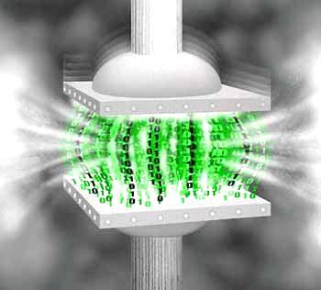




Data compression
Compression algorithms, data backup software

Slide 27
Data compression
The questions from this section on the compendium shall cover the following areas:
Compress and decompress data. Coding without and with loss. Coding with linear prediction. Algorithms of Shannon-Fano, Huffman. Arithmetic coding. Hosting of Web sites encoding: LZ-77 and LZW. JPEG encoding. Backup programs – work with WinZIP and WinRAR. Create and principle of action of the self-extracting installation archives.

Slide 28
Question
What does Game RIP stand for?
A pirated version of a game that was stripped down
A game in which primary goal is to bury as many people as you can
Software company specializing in games development
First console game
Other meaning

Slide 29
Answer
Information: A game rip (or gamerip) refers to a pirated version of a game that was stripped down in order to fit under scene rules. With the rise of broadband internet across large parts of the world, releases of multiple CD and DVD sized games become a feasible process and the images provided by groups were in fact direct copies of the original CD image, usually with copy protection bypassing tools supplied either as part of the image or in a separate archive.
Source:
http://en.wikipedia.org/wiki/Game_rip

Slide 30



Word Processing
Working with text editing software software, file formats, encodings, text, tables, figures, ...

Slide 31
Word Processing
The questions from this section on the compendium shall cover the following areas:
Computer processing of texts.
Types of file formats (TXT, DOC, DOCX, RTF), convert.
Ways to encode the text information (coding tables and standards, Unicode, Windows-1251, ASCII).
Problems in ensuring MultiLanguage.

Slide 32
Word processing (2)
Major components of the text layout (paragraphs: alignment, spacing between lines and paragraphs, text: fonts, distances between letters, coloring, font size, effects). Standards for layout of texts. Work with styles. Insert symbols and images. Insert tables. Grooming tables, rows/columns, and cells. Insert text fields. Draw shapes. Grooming (formatting): frame background. Insert a new page, the section numbering, table of contents.

Slide 33
Question
Which of the following is NOT a solution for note taking?
Еvernotе
Microsoft OneNote
Google Keep
Sugar Sync
SimpleNote

Slide 34
Answer
Information: SugarSync is a cloud service that enables active synchronization of files across computers and other devices for file backup, access, syncing and sharing from a variety of operating systems, such as Windows, Mac OS X, iOS, Android, Symbian devices, etc.
Source:
Evernote - www.evernote.com
MS OneNote - http://office.microsoft.com/bg-bg/onenote/
Simple Note - http://simplenote.com/
Google Keep - https://drive.google.com/keep
SugarSync - https://www.sugarsync.com/

Slide 35
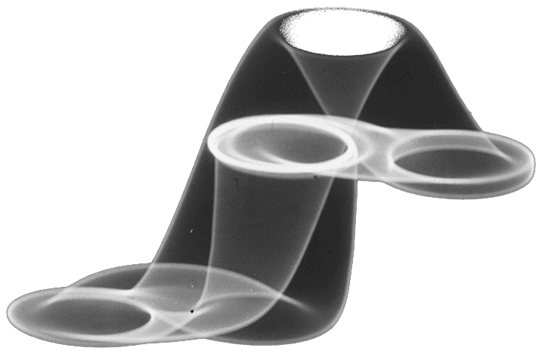



Computer graphics
Raster and vector graphics, image file formats, image editors, color schemes

Slide 36
Computer graphics
The questions from this section on the compendium shall cover the following areas:
Computer graphics. Graphic file formats (JPG, GIF, PNG, TIFF, EPS, PSD, AI, CDR). Compression of images. Vector and graphic images. Converting graphic formats. Applications (creating graphic images, analysis and image recognition, computer art). Graphics editors for images. Filters and effects. Colors: RGB, CMYK, Panton, 16-bit color.

Slide 37
Question
Image compression can be lossless or lossy. Which of the following methods is used for lossy compression?
Entropy encoding
Chain code
Chroma subsampling
Run-length encoding
PNG

Slide 38
Answer
Information: Chroma subsampling is the practice of encoding images by implementing less resolution to convey the color information of the picture than for luma information (brightness), taking advantage of the human visual system's lower acuity for color differences than for luminance. PNG is not a method, it is a file format that supports lossless data compression.
Source:
http://en.wikipedia.org/wiki/Image_compression#Lossy_and_lossless_compression
http://en.wikipedia.org/wiki/Chroma_subsampling
http://en.wikipedia.org/wiki/Portable_Network_Graphics

Slide 39




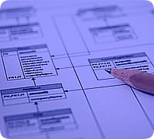

Databases
Models of data, tables, relationships, SQL

Slide 40
Databases
The questions from this section on the compendium shall cover the following areas:
Databases. Systems for management of databases. Logical and physical organization. Data models.
Relational databases. Tables and relationships. Objects in the databases. Types of data.
SQL Language. Types of SQL commands and requests.

Slide 41
Question
Which command in the SQL alter database item under some condition?
UPDATE ... SET ... WHERE ...
CONVERT … TO … WHEN …
IF … SET … CHANGE …
REPLACE … WITH … WHEN
UPDATE … POSITION … IF

Slide 42
Answer
Information: UPDATE table_name SET column_name = value [, column_name = value ...] [WHERE condition]
Source:
http://en.wikipedia.org/wiki/SQL
http://en.wikipedia.org/wiki/Data_manipulation_language
http://en.wikipedia.org/wiki/Update_(SQL)

Slide 43

Information systems
ERP, CRM, BI, BPM, FMIS, CAD/CAM, CMS, software architectures

Slide 44
Information systems
The questions from this section on the compendium shall cover the following areas:
Information systems. Classification (organisation management – ERP, production management, relations with customers and suppliers – CRM reports, analyses and forecasts-BI to solve specific problems, ...). Life cycle (the main stages in the creation and use). Basic functions and tasks. System architectures – double-layer (client/server), triple-layer, N-layer (distributed), cloud computing.

Slide 45
Question
In business intelligence(BI) a data warehouse refers to:
A storage facility for data devices
C# programming library
A collection of copied subject-oriented data specifically structured for query and analysis
XAML instructions database
A temporary storage for user files before data encryption

Slide 46
Answer
Information: Data warehouse is a set of thematically-focused, integrated, time-aligned and reliably stored data to facilitate and assist in the decision making process of the manual. It is a copy of transaction data specifically structured for inspection and analysis. A central repository for data created by pooling data from one or more heterogeneous sources.
Source:
http://en.wikipedia.org/wiki/Data_warehouse
http://www.1keydata.com/datawarehousing/data-warehouse-definition.html

Slide 47


Security and protection of information
Symmetric and asymmetric encryption algorithms, cryptographic hashing, digital signature, digital certificates

Slide 48
Security and protection of information
The questions from this section on the compendium shall cover the following areas:
Security and protection of information. Methods and algorithms for encryption: symmetric cryptographic algorithms: DES, 3DES; Asymmetric cryptographic algorithms (with a public and private key) RSA, DSA. Cryptographic algorithms, SHA-1, MD5. Electronic signature. Public key infrastructure (PKI). Digital certificates.

Slide 49
Question
When creating a digital signature, which key is used by the sender to encrypt the message digest of the document?
The private one
The public one
The biggest one
The hash function

Slide 50
Answer
Information: When using digital signatures, the sender of the message generates the message digest of the document using a hash function, then encrypts it with his private key.
Source:
http://upload.wikimedia.org/wikipedia/commons/0/0f/Digital_signature_schema.gif
http://en.wikipedia.org/wiki/Digital_signature
http://en.wikipedia.org/wiki/Public-key_cryptography
http://en.wikipedia.org/wiki/Hash_function

Slide 51




Presentation systems
Software for presentations, preparation of presentations, slides, effects, notes, colors, images, sound, video

Slide 52
Presentation systems
The questions from this section on the compendium shall cover the following areas:
Presentation of information by means of information technology. Computer presentation-slide effects, notes, color scheme, templates.
Design of presentation materials – using colors, text, images, sound, animation and video.
Software for presentations (presentation systems).

Slide 53
Question
Which of the following is Adobe’s presentation software?
Adobe Acrobat Reader
Adobe Premiere Pro
Adobe InDesign
Adobe Presenter
Adobe Frame Maker

Slide 54
Answer
Informat Acrobat reader is for viewing text. Adobe Premiere Pro is a video-editor. Adobe InDesign graphic design software. Adobe Frame Maker is a document processor. Adobe Presenter, is Adobe’s presentation software.
Source:
http://www.adobe.com/bg/products/presenter/faq.html
http://en.wikipedia.org/wiki/List_of_Adobe_software
http://en.wikipedia.org/wiki/Adobe_InDesign
http://en.wikipedia.org/wiki/Adobe_FrameMaker
http://en.wikipedia.org/wiki/Adobe_Premiere_Pro

Slide 55
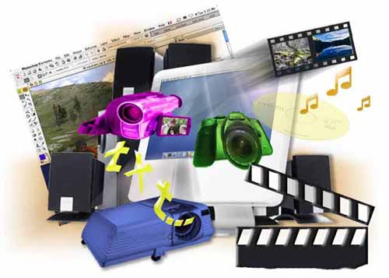



Multimedia
Software for creating/processing of multimedia: sound, video, file formats

Slide 56
Multimedia
The questions from this section on the compendium shall cover the following areas:
Multimedia. Technology for creating multimedia applications. Software tools for creating multimedia products. Generating animation and movies (insert and processing of images, sound, text). Compression of multimedia files. Converting multimedia file formats. Software for playing multimedia, animation and movies.

Slide 57
Question
Which of the following video formats can NOT be played from a Blu-Ray drive:
H.262/MPEG-2
Xvid
VC-1
H.264/MPEG-4
None of the above

Slide 58
Answer
Information: To play video from Blu-Ray Disks, players have to support H.262/MPEG-2 Part 2, H.264/MPEG-4 Part 10: AVC, and SMPTE VC-1. BD-ROM titles with video must store video using one of the three mandatory formats; multiple formats on a single title are allowed.
Source:
http://en.wikipedia.org/wiki/Blu-ray_Disc#Codecs
http://en.wikipedia.org/wiki/Comparison_of_video_codecs

Slide 59


Computer networks
OSI model, network models, protocols, standards, hardware equipment

Slide 60
Computer networks
The questions from this section on the compendium shall cover the following areas:
Computer networks. Architecture of the OSI model. Network protocols.
Local networks – concepts, types, according to the Organization of management, topology, the basic standards, hardware components.
Global computer networks – concepts, ways of connecting, addresses, basic services. Users and access to resources.

Slide 61
Question
Assuming all devices are working properly, choose the path with the lowest latency for transferring data between PC1 and PC2:
PC1->switch->router->switch->PC2;
PC1->hub->router->switch->PC2;
PC1->switch->switch->firewall>PC2;
PC1->hub->switch->hub->PC2;
PC1->router->firewall->router->PC2;

Slide 62
Answer
Information: Every device adds certain amount of latency to the traffic traversing the network, depending on the type of information it processes. Knowing on which layer of the OSI model the device operates may help us determine the approximate delay that the device will add to the network traffic.
Source:
http://support.microsoft.com/kb/103884
http://en.wikipedia.org/wiki/Router_(computing)
http://en.wikipedia.org/wiki/Network_switch
http://en.wikipedia.org/wiki/Ethernet_hub
http://en.wikipedia.org/wiki/Firewall_(computing)

Slide 63



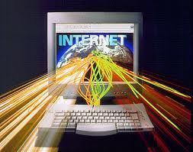
A device on the Internet
Internet, protocols, services, WWW, HTTP, FTP, SMTP, POP3, IMAP, WebDAV, IP, DNS, ...

Slide 64
A device on the Internet
The questions from this section on the compendium shall cover the following areas:
Internet – actually, technically and tehnolo-technological aspects. Client-server architecture.
Basic services and protocols — HTTP, FTP, POP3, SMTP.
Types of Internet access – dial-up, ISDN, LAN, DSL/ADSL, Wi-Fi.
Internet addresses-IP addresses, DNS services, top level domains. Hosting.

Slide 65
Question
A set of communication standards for simultaneous digital transmission of voice, video, data, and other network services over the traditional circuits of the public switched telephone network refers to?
ADSL
ISDN
Dial-up
DNS
None of the above

Slide 66
Answer
Information: Integrated Services for Digital Network (ISDN) is a set of communication standards for simultaneous digital transmission of voice, video, data, and other network services over the traditional circuits of the public switched telephone network. Prior to ISDN, the telephone system was viewed as a way to transport voice, with some special services available for data. ISDN is integrates speech and data on the same lines.
Source:
http://en.wikipedia.org/wiki/ISDN

Slide 67


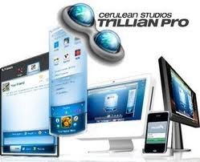


Electronic communication
E-mail, Skype, ICQ, IRC, MSN Messenger, Yahoo Messenger, social networks, forums, ...

Slide 68
Electronic communication
The questions from this section on the compendium shall cover the following areas:
Electronic communication.
E-mail-e-mail clients and Web-based interfaces and protocols.
Conversations in real time – IRC, ICQ, Skype, MSN Messenger, Yahoo Messenger – principles of action and protocols.
Social networks.

Slide 69
Question
Which of the following is email protocol?
RIP
HTTP
SSH
SMTP
FTP

Slide 70
Answer
Information: SMTP (Simple Mail Transfer Protocol) is the Internet standard host-to-host email transport protocol and traditionally operate with TCP port 25. The SMTP protocol is used by most e-mail systems that send mail. The letters can then be downloaded by POP3 or IMAP from a local client or program. SMTP Protocol is designed to be equally useful in any computer and user.
Source:
http://bg.wikipedia.org/wiki/SMTP

Slide 71




World Wide Web (WWW)
How does the WWW? The Protocol HTTP, GET, POST, URL, Web browser, Web page, Web site, ...

Slide 72
World Wide Web (WWW)
The questions from this section on the compendium shall cover the following areas:
Global information system on the World Wide Web (WWW) – nature and functioning.
Web servers and Web browsers. Protocol HTTP GET and POST methods. Hyperlink technology (Internet links).
Web page – the nature, purpose, and URL elements.
Hosting of Web sites.

Slide 73
Question
A program that traverses the hypertext, following each hyperlink and gathering all the retrieved documents is known as:
Web detective
Wet navigator
Web scanner
Web crawler / spider
Internet logger bot

Slide 74
Answer
Information: A Web crawler is an Internet bot that systematically browses the World Wide Web, typically for the purpose of Web indexing. Web crawlers can copy all the pages they visit for later processing by a search engine that indexes the downloaded pages so that users can search them much more quickly. Crawlers can validate hyperlinks and HTML code.
Source:
http://en.wikipedia.org/wiki/Web_crawler
http://www.wisegeek.org/what-is-a-web-crawler.htm

Slide 75


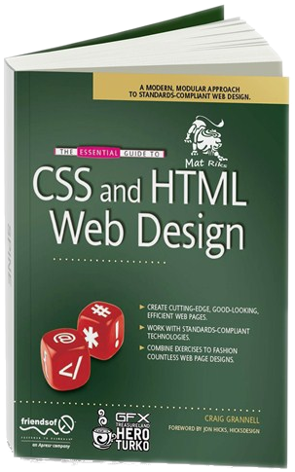

Web design, HTML, CSS
Web design, HTML, CSS, text, graphics, links, tables, forms ...

Slide 76
Web design, HTML, CSS
The questions from this section on the compendium shall cover the following areas:
Planning, design, development and testing of Web sites.
Basic HTML tags: Insert formatted text, images, links (backlinks), tables.
Styling language websites CSS.
Align the content in a Web page.

Slide 77
Web design, HTML, CSS (2)
Characteristics of page (background, color, images, align, titles of pages, encoding of pages, meta tags), paragraphs, fonts, colors, insert images.
Conversion of Web design (thumbnail) to a Web site. Content management systems.
Frames (frames). Navigation: transfer of management in frames (frames).

Slide 78
Question
Which of the following IS wrong?
The web banner is a form of advertising on the internet delivered by an ad server
The web banner entitles embedding an advertisement into a web page
The web banner is used as a hyperlink between a third-party’s website and an advertiser’s website and, thus the banner attracts traffic to the advertiser’s website
The use of a proxy server blocks banners and thus allows users to avoid them
The banners developed with Flash and Java use raster graphics just like the traditional ones

Slide 79
Answer
Information: In fact, the banners developed with Flash and Java use vector graphic which allows the developer to use animation effects even on small sized banners.
Source:
http://bg.wikipedia.org/wiki/%D0%A3%D0%B5%D0%B1_%D0%B1%D0%B0%D0%BD%D0%B5%D1%80
http://en.wikipedia.org/wiki/Web_banner

Slide 80





JavaScript
Development of scripts with JavaScript, a basic JavaScript structures, operators, objects, manipulation of the DOM tree

Slide 81
JavaScript
The questions from this section on the compendium shall cover the following areas:
Scripting languages for programming the Web: JavaScript, Perl, VBScript. General information about JavaScript. Data types. Variables. Assignment operator. Operations and expressions. A conditional operator. Cycle operators. Functions in JavaScript. Objects in JavaScript. Arrays. Date Math Classes. Objects document, window, navigator. Events in JavaScript. The DOM object model and manipulation with JavaScript.

Slide 82
Question
Which is NOT true about JavaScript??
Its syntax was influenced by C#
JavaScript has dynamic typing and first-class functions
Variables in JavaScript are declared with the keyword “var”
It was developed my Microsoft Corporation while battling Netscape over the Internet
The first official name of the language was LiveScript

Slide 83
Answer
Information: In fact, it was the other way around. Netscape developed JavaScript as a lightweight interpreted language that would complement Java by appealing to the nonprofessional programmers.
Source:
http://en.wikipedia.org/wiki/JavaScript

Slide 84
Telerik Academy for high school students
?
?
?
?
?
Any Questions ?
Like you need more :D :D:D
?
?
?
?
?
http://schoolacademy.telerik.com

